Slide 1
Thesis Defense
Analyzing Motorcycle Crashes on Rural Undivided Roads: A Data-Driven Approach
Presented by
Swastika Barua
June 24, 2025

Slide 2



Acknowledgement
Committee Chair
Dr. Subasish Das
Assistant Professor,
Texas State University
Committee Members
Dr. Anandi K Dutta
Assistant Professor,
Texas State University
Dr. Krishna Kisi
Associate Professor
Texas State University

Slide 3
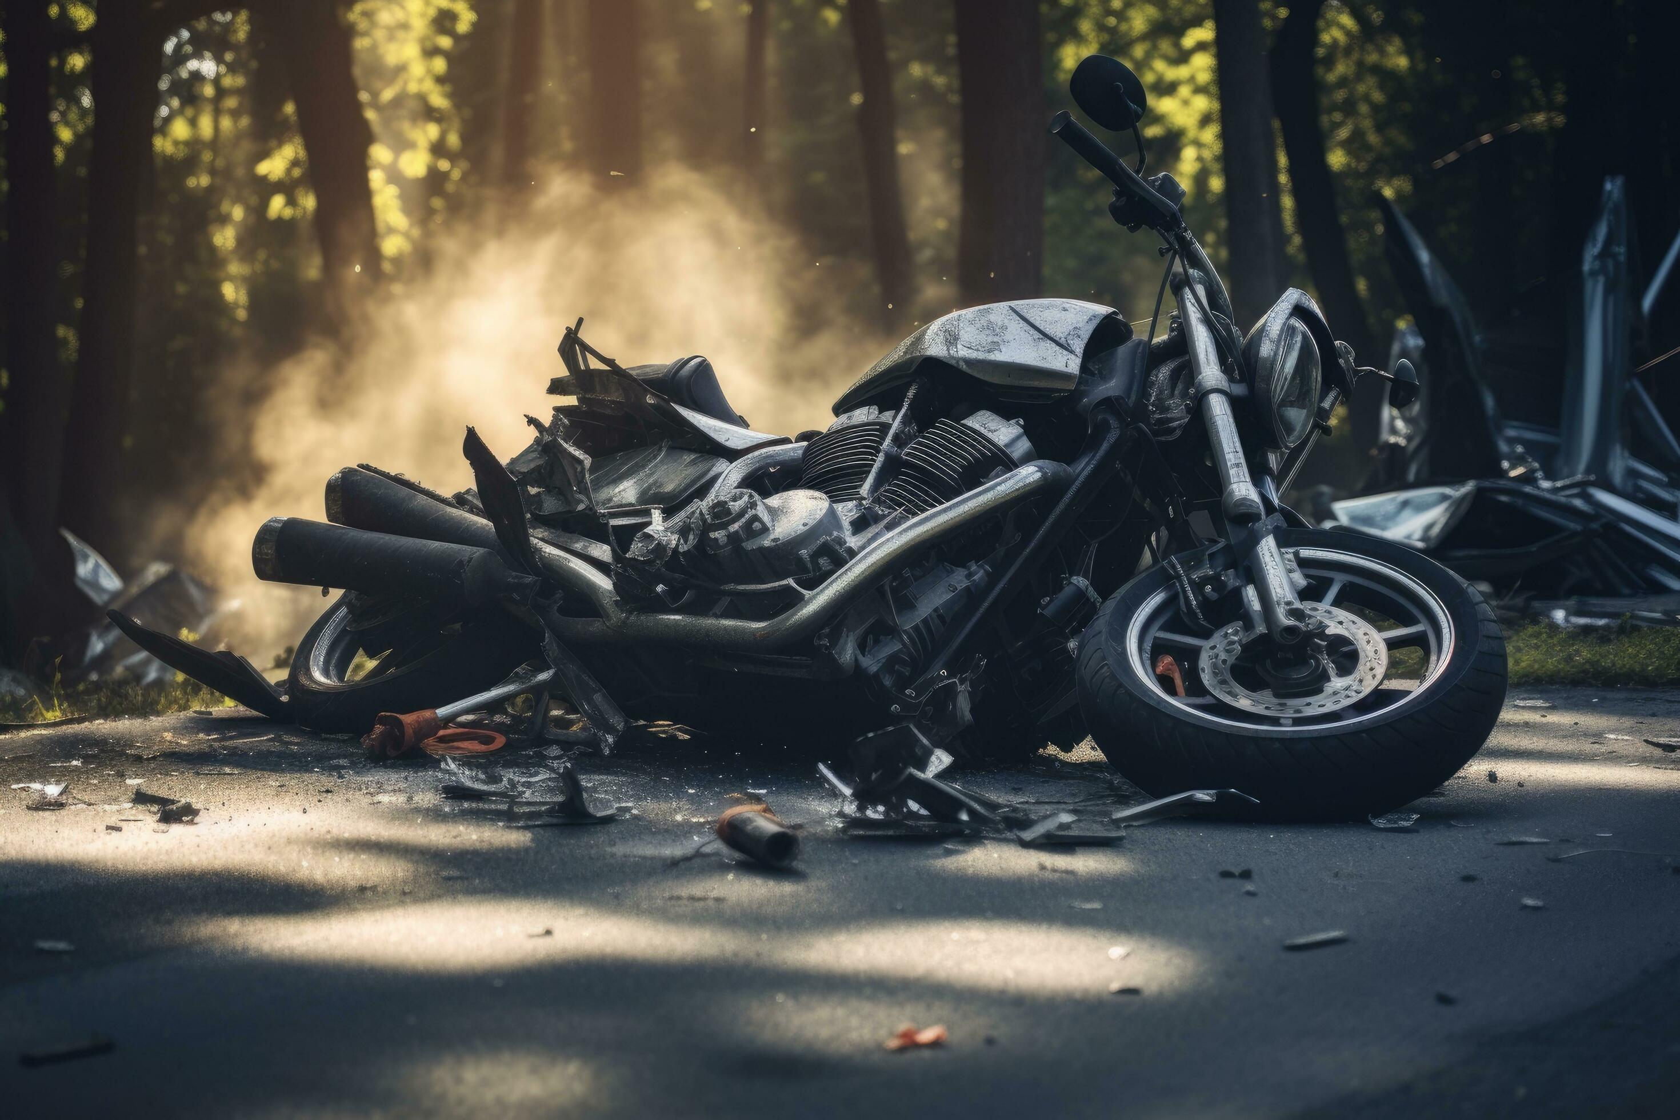
Outline
Literature review
Research motivation
Data description and study design
Methodological framework
Tabular and text data analyses
Convergent validity
Limitation and future scope

Slide 4

Traffic Safety Facts
15%
In 2022, 6,218 motorcyclists were killed, making up 15% of all traffic fatalities
35%
35% of motorcycle riders in fatal crashes did not have valid motorcycle licenses
42%
42% of motorcycle riders who died in single-vehicle crashes were alcohol-impaired.
¹Traffic Safety Facts - Motorcycle (2022)

Slide 5
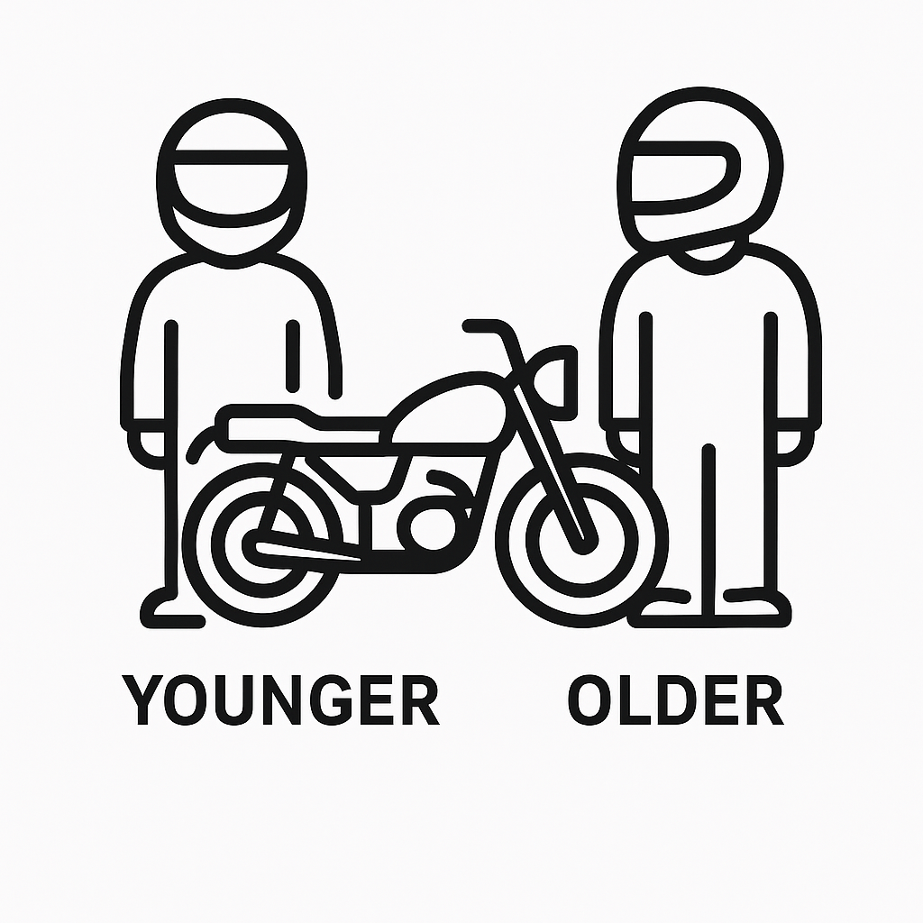

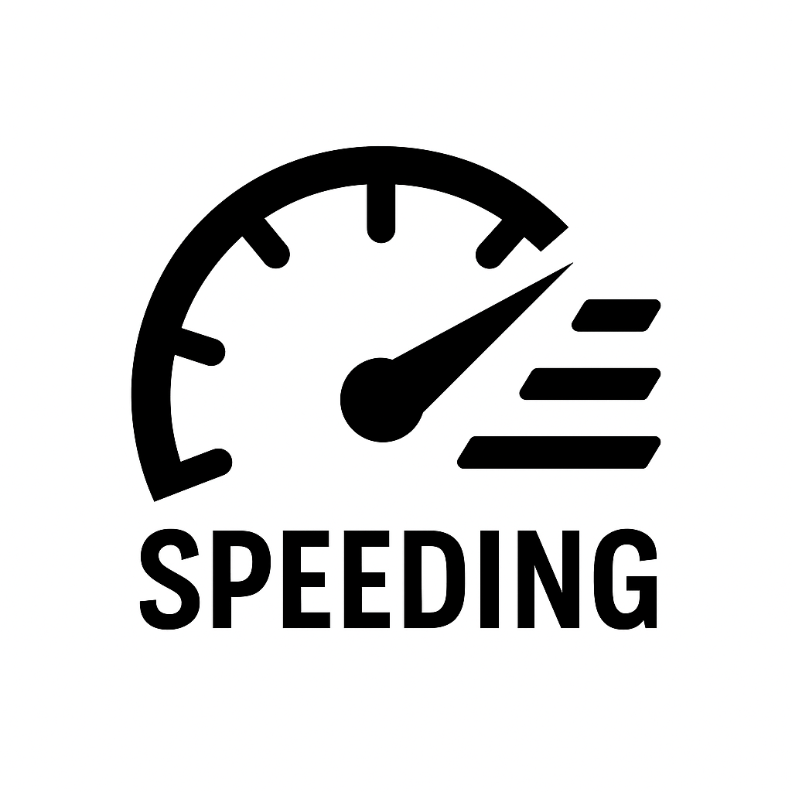

Literature Review
Rider Demographics
Younger and less experienced riders have higher crash risk (Islam, 2021; Goodwin et al., 2022).
Older riders suffer more severe injuries due to frailty (Phillips et al., 2013).
Helmet Use
Helmets reduce fatal and serious head injuries; effectiveness varies by helmet type and usage (Khor et al., 2017; Christian et al., 2014; De Rome et al., 2012).
Speeding
Fatigue and risky actions like speeding and aggressive riding are linked to more crashes (Truong et al., 2020; Stephens et al., 2017; Cheng et al., 2011; Islam and Brown, 2017).
Road Infrastructure
Rural roads, sharp curves, poor lighting, and fixed objects increase severity (Islam and Brown, 2017; Haque et al., 2012; Khan et al., 2013; Xin et al., 2017b; Das et al., 2022).

Slide 6
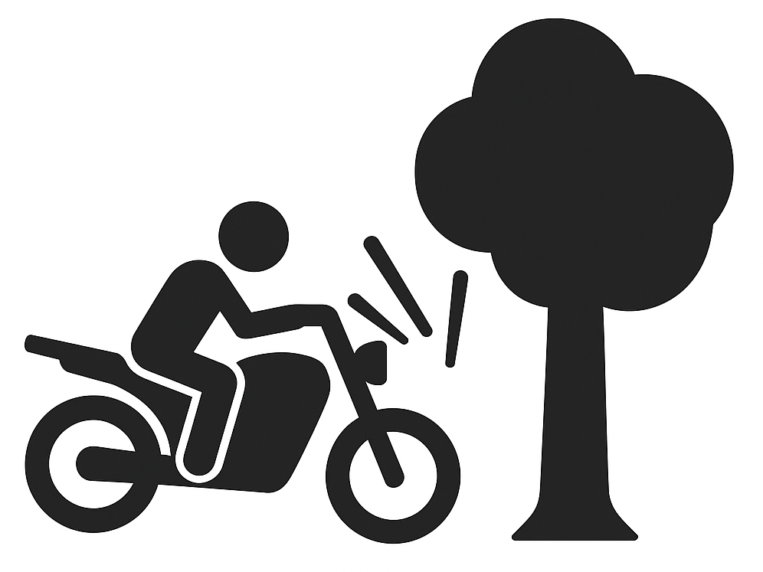
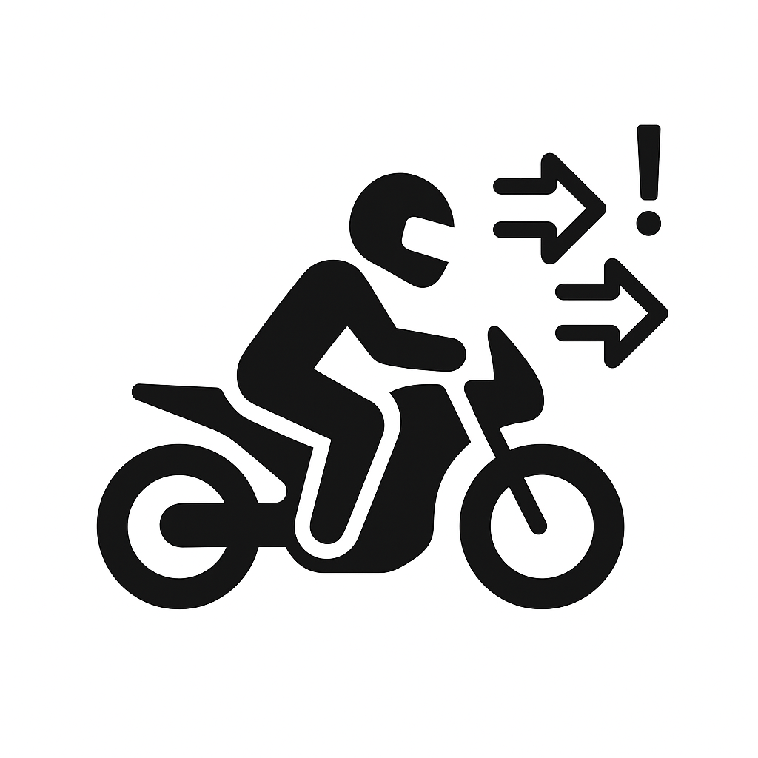
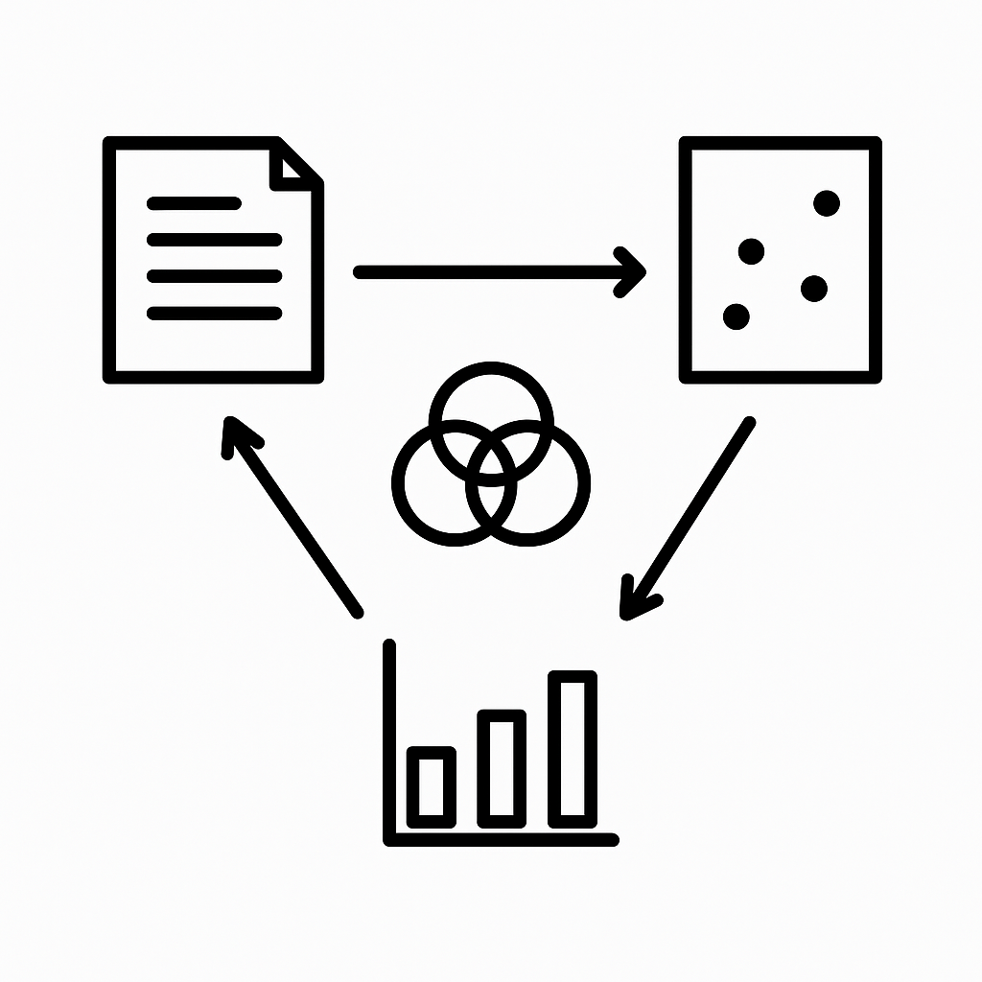
Research Gap
Most studies focus on barrier safety but often neglect the impact of roadside fixed objects
Research on rural undivided roads mainly addresses road geometry and pavement, overlook the factors interacting with rider behavior.
Few studies combine topic modeling from crash narratives with advanced econometric models and correspondence analysis

Slide 7

Research Objective and Questions
The objective of the research is to analyze factors contributing to motorcycle crashes on rural undivided roads using a data-driven approach that incorporates text analysis, pattern recognition, and advanced statistical modeling to identify key behavioral, environmental, and roadway influences on injury severity.
RQ1. What behavioral, environmental, and roadway characteristics are most strongly associated with severe and fatal motorcycle crashes on rural undivided roadways, as identified through cluster correspondence analysis?
RQ2. How does unobserved heterogeneity influence the relationship between crash risk factors and injury severity across different crash clusters on rural undivided roadways?
RQ3. What key themes and topics emerge from the narrative crash data, and how do these narrative-driven factors relate to crash severity outcomes?
RQ4. How do the type and nature of the first harmful event influence injury severity in motorcycle crashes, and what factors explain variability in their impact?

Slide 8
Why Rural Undivided Road Segments?

Slide 9
Why Rural Undivided Road Segments?

Slide 10
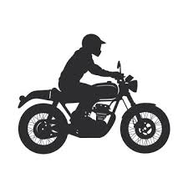

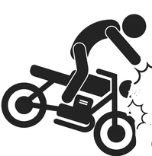
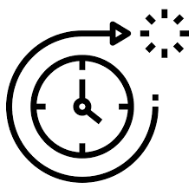
Data Description
This research collected seven years (2017–2023) of motorcycle crash data from Texas CRIS database, covering 58,221 crashes categorized by severity: K (fatal injury), A (incapacitating injury), B (non-incapacitating injury), C (possible injury), O (no injury)
Age Group
Ethnicity
Gender
Helmet Use
Roadway Alignment
Intersection Related
Crash Speed
Lighting Condition
Traffic Condition
Rider Demographic and Behavior
Roadway Characteristics
Contributing Factor
First Harmful Event
Harmful Event
Object Struck
Crash Hour
Day Type
Season
Weather
Crash Characteristics
Temporal Factors

Slide 11
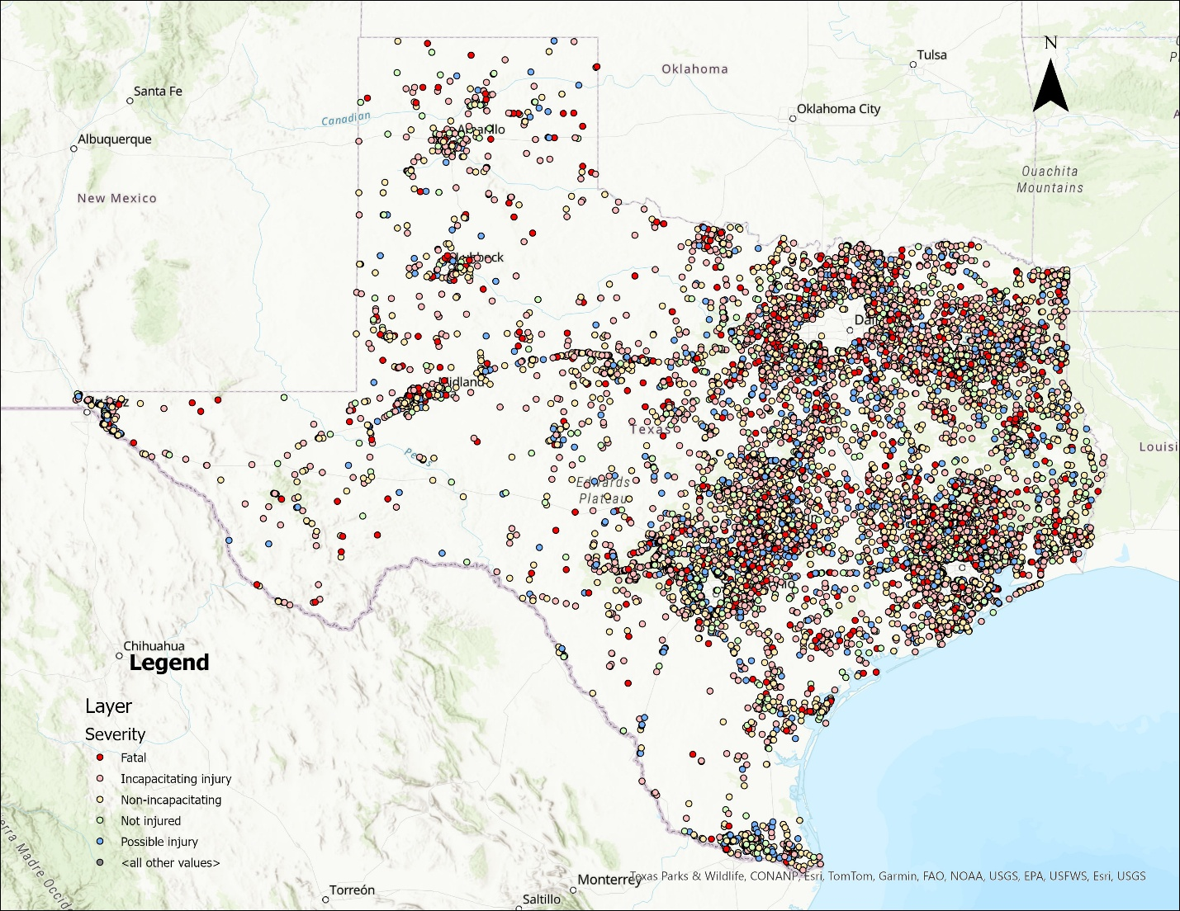
CRIS Dataset
Data Source: Texas CRIS Database
Total Observations: 58,221 motorcycle crashes
Study dataset: a data subset of 12,753 crashes was prepared based on rural, undivided roadway segments, including both two-lane and four-or-more-lane roads.
Severity | Count
K | 1,143
A | 4,080
B | 4,032
C | 1,802
O | 1,696
Grand Total | 12,753

Slide 12







Research Approach
Motorcycle crashes on rural undivided roads
Modeling Approach
12,753 Observations, 20 Variables
Multimodal Data Framework
Structured Data
Cluster Correspondence Analysis (CCA)
Cluster-Based Random Parameter Models
Data Preprocessing
Validation: SHAP Summary Plots
Cross Validation
2017 to 2023
Texas Crash Dataset (58,221 observations)
Narrative Data
Bigram Topic Modelling

Slide 13
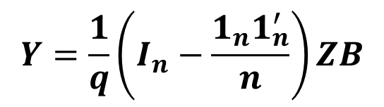
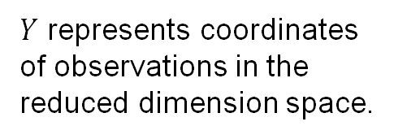
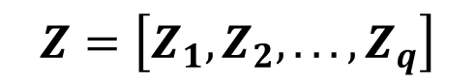
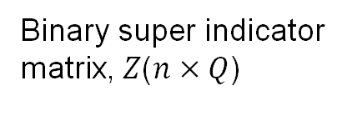
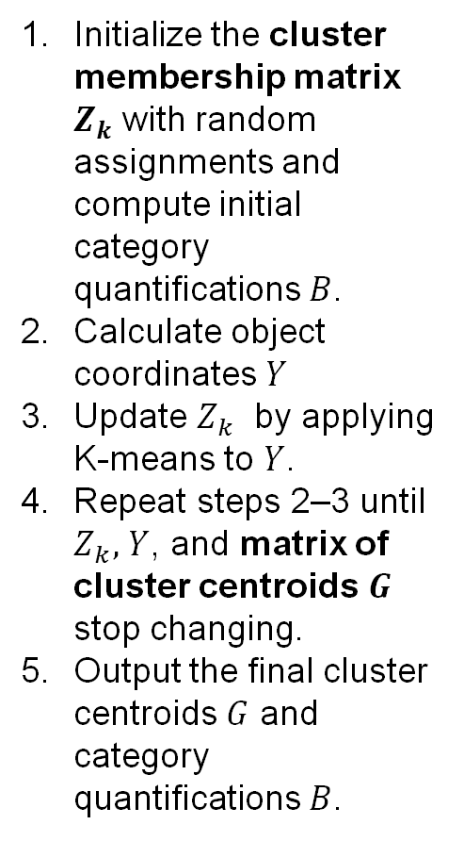
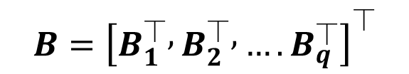
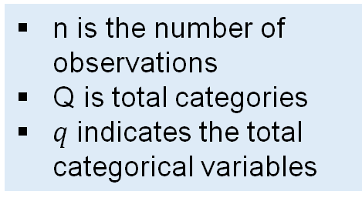
Methodology (CCA Steps)
Initialize the cluster membership matrix $Z_{k}$ with random assignments and compute initial category quantifications $B$.
Calculate object coordinates $Y$
Update $Z_{k}$​ by applying K-means to $Y$.
Repeat steps 2–3 until $Z_{k},$ $Y$, and matrix of cluster centroids$G$ stop changing.
Output the final cluster centroids $G$ and category quantifications $B$.
$$Z=\left[Z_{1},Z_{2},...,Z_{q}\right]$$
Binary super indicator matrix, $Z$($n×Q$)
(encodes all categories of all variables)
n is the number of observations
Q is total categories
$q$ indicates the total categorical variables
$$Y=\frac{1}{q}\left(I_{n}−\frac{1_{n}1_{n}^{′}}{n}\right)ZB$$
$Y$ represents coordinates of observations in the reduced dimension space.
$$B={\left[B_{1}^{⏉} , B_{2}^{⏉} , ….B_{q}^{⏉}\right]}^{⏉}$$
Category quantification matrix.
(helps transform categorical data into numerical space)

Slide 14
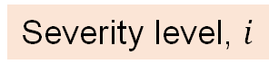

Methodology (Random Parameter Logit Model)
The Model Equation
Observed factors (e.g., helmet use, crash speed)
$$S_{ij}=β_{i}X_{ij}+ε_{ij}$$
Unobserved random error
Severity level, $i$
Parameters
KA: Fatal or Severe
BC: Moderate or Possible
O: No Injury
For each crash, the model adds up the effect of all the factors (with weights) to get a “score” for each injury severity. The higher the score, the more likely that severity outcome.

Slide 15
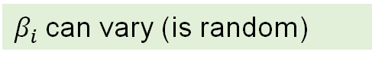
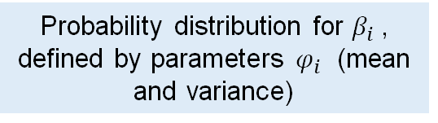

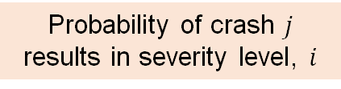
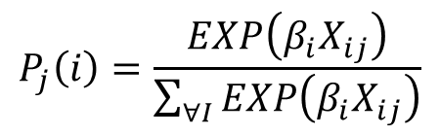
Methodology (Random Parameter Logit Model)
Basic Multinomial Logit Probability
Mixed Logit Model for Unobserved Heterogeneity
Likelihood for severity 𝑖 given the factors
$β_{i}$can vary (is random)
$$P_{j}\left(i\right)=\frac{EXP\left(β_{i}X_{ij}\right)}{\sum_{∀I}{EXP\left(β_{i}X_{ij}\right)}}$$
$$P_{j}\left(i\right)=\int{\frac{EXP\left(β_{i}X_{ij}\right)}{\sum_{∀I}{EXP\left(β_{i}X_{ij}\right)}}}f\left(β_{i}\left|φ_{i}\right.\right)dβ_{i}$$
Sums up likelihoods for all possible severities
Probability distribution for $β_{i}$​, defined by parameters $φ_{i}$​ (mean and variance)
Probability of crash $j$ results in severity level, $i$
Instead of using a single value for each parameter (like effect of speed), the model allows these effects to vary between crashes, capturing real-world randomness.
This equation turns each severity’s score into a probability by dividing by the sum of scores for all severities.

Slide 16

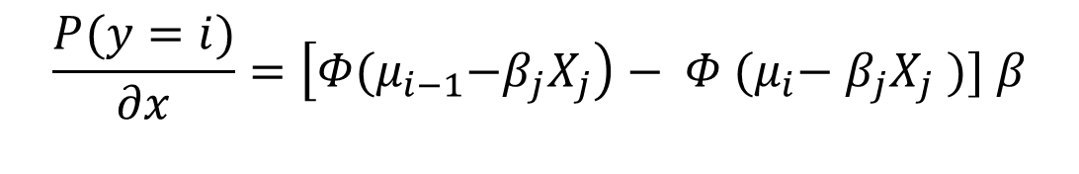
Methodology (Random Parameter Logit Model)
Marginal Effects
$$\frac{P(y=i)}{∂x}=\left[Φ{(μ}_{i−1}−β_{j}X_{j}\right)− Φ {(μ}_{i}− β_{j}X_{j} )] β$$
Threshold values for injury severity level $i$
If a rider changes from wearing a helmet to not wearing one (i.e., from 1 to 0), the model quantifies how the probability of sustaining a fatal injury (KA) increases or decreases.

Slide 17
Methodology (Topic Modeling)
NLP Preprocessing
Identify noise
Noise removal
Character normalization
Data masking
Source Text
Clean Text
Prepared Text
Named-entity recognition
Lemmatization
POS tagging
Tokenization
Latent Dirichlet Allocation (LDA) Model
Topic Creation
Dirichlet parameter
Document topic distribution
Word topic assignment
Observed word
Frequency of topics

Slide 18

CCA and Results

Slide 19
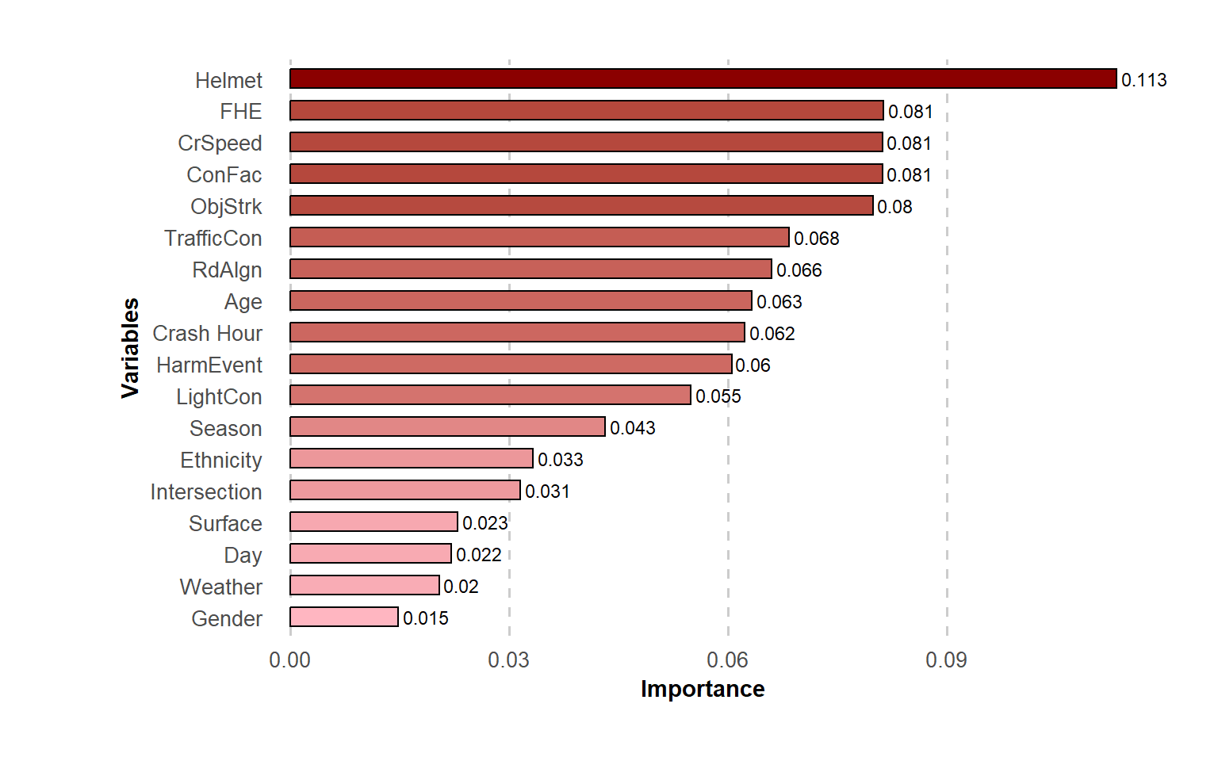
Variable Importance Analysis (XGBoost)

Slide 20
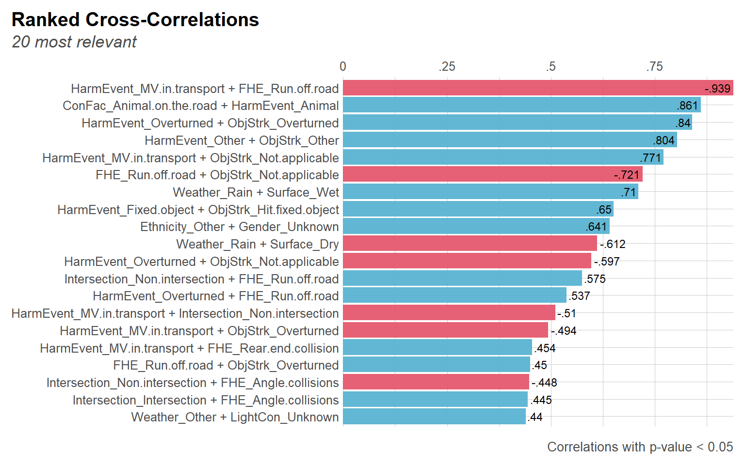
Cross-Correlation/pairwise correlation

Slide 21
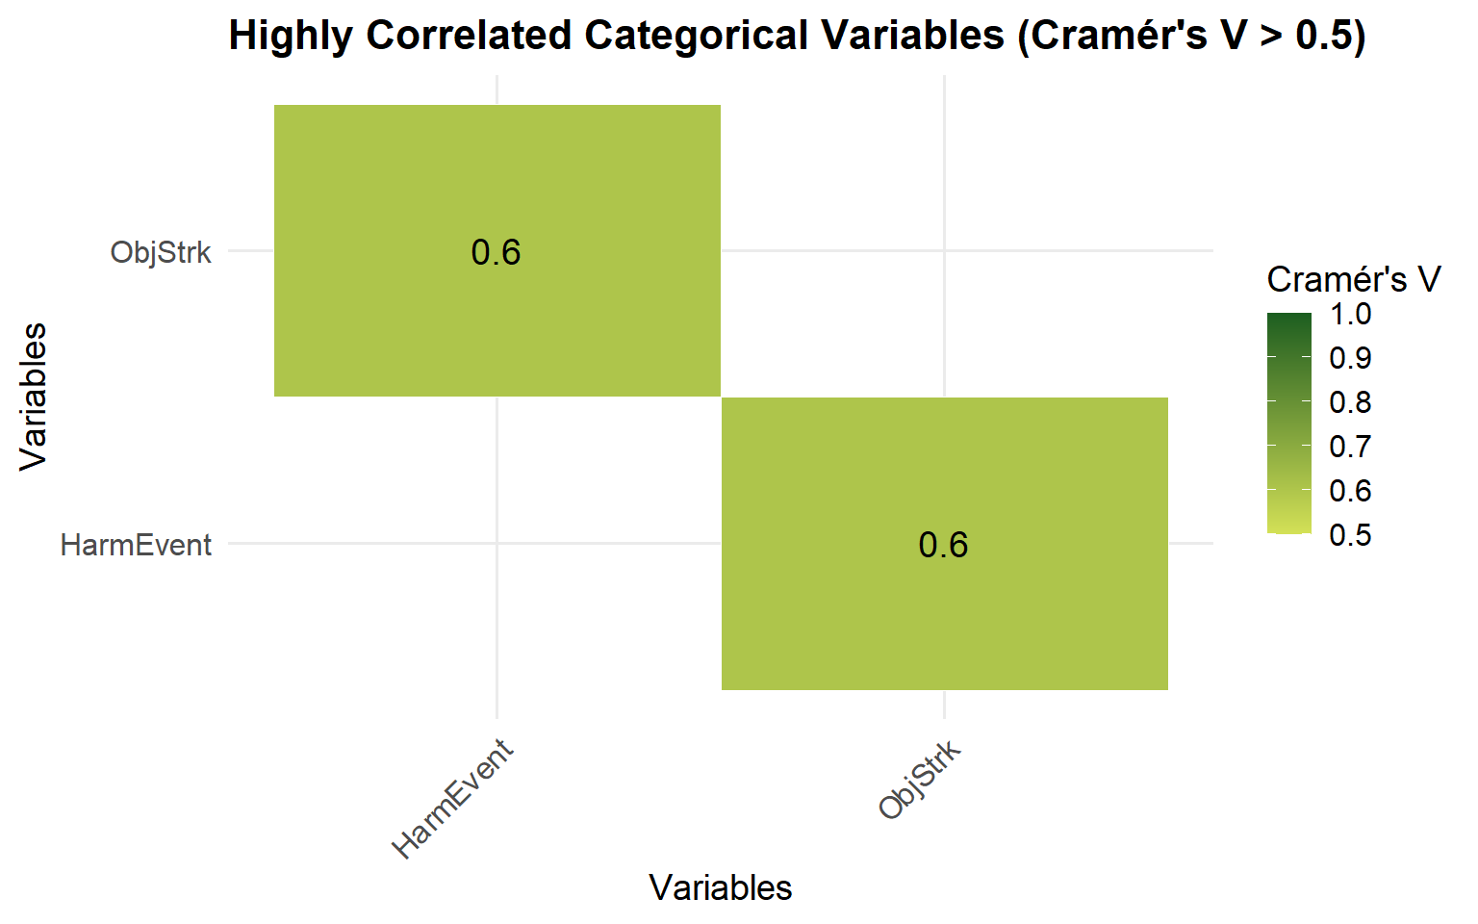
Variable Selection for CCA
Threshold:
Importance score up to 0.04
Variable Pair | Reason | Comment
HarmEvent & ObjStrk_Overturned | Strong correlation (0.84) | keep only one
FHE_Run.off.road & HarmEvent_MV.in.transport | Strong negative correlation (–0.93) | redundant
Weather_Rain & Surface_Wet | Strong correlation (0.71) | keep only one
Intersection & FHE | Moderate correlation (0.57) | multicollinearity

Slide 22
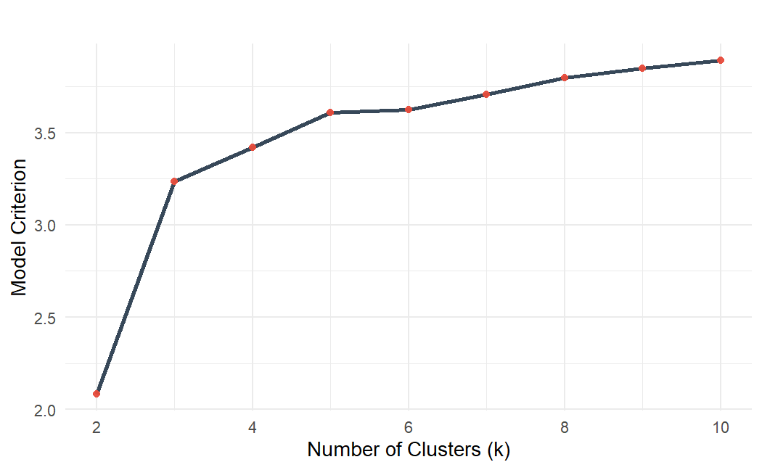
Optimum Cluster Number: Elbow Method
k | Criterion
4 | 3.421034
5 | 3.610805
6 | 3.624342
7 | 3.706446
8 | 3.798688
9 | 3.849937
10 | 3.89122

Slide 23
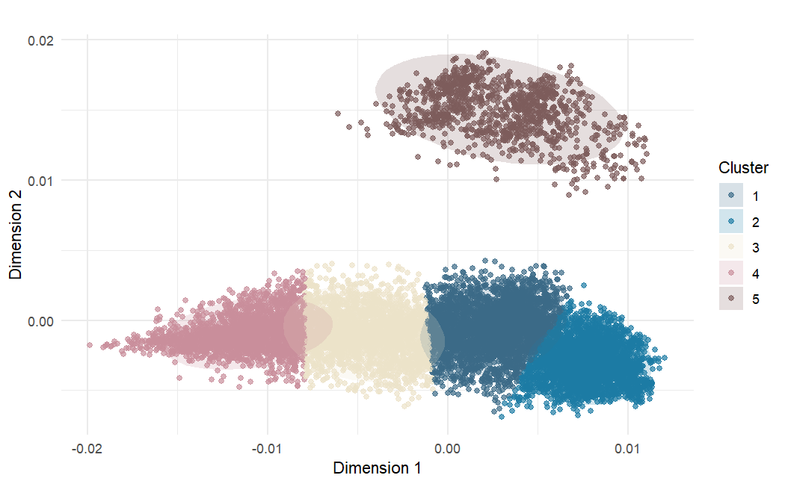
CCA-Biplot
C5
C4
C3
C1
C2

Slide 24
Cluster Correspondence Analysis (CCA)
Cluster | Size and Percentage | Dimension 1 | Dimension 2 | Within Cluster Sum of Square
Cluster 1 | 3382 (26.5%) | 0.0025 | -0.0005 | 0.0201
Cluster 2 | 3354 (26.3%) | 0.0078 | -0.0031 | 0.0148
Cluster 3 | 2577 (20.2%) | -0.0046 | -0.0010 | 0.0168
Cluster 4 | 2324 (18.2%) | -0.0112 | -0.0009 | 0.0152
Cluster 5 | 1116 (8.8%) | 0.0030 | 0.0149 | 0.0147
Between Cluster Variance: Total Between_SS / Total_SS = 91.41 % Objective Criterion Value = 3.6108

Slide 25
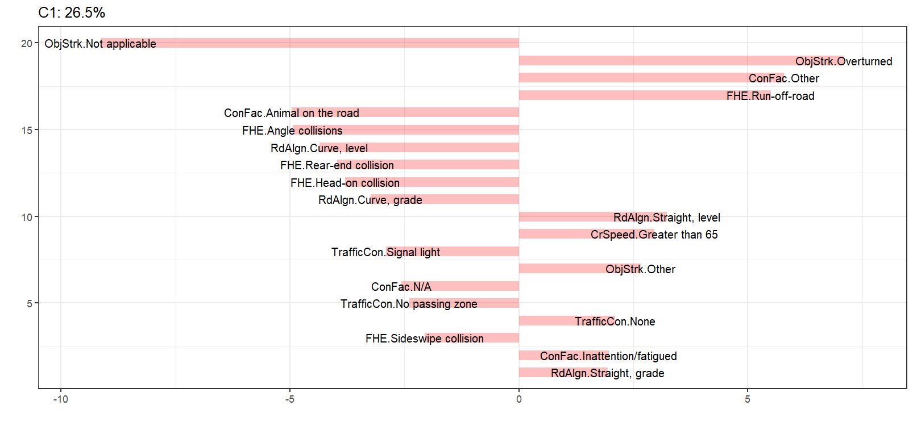
Cluster 1 Overturns and run-off-road crashes at high speeds

Slide 26
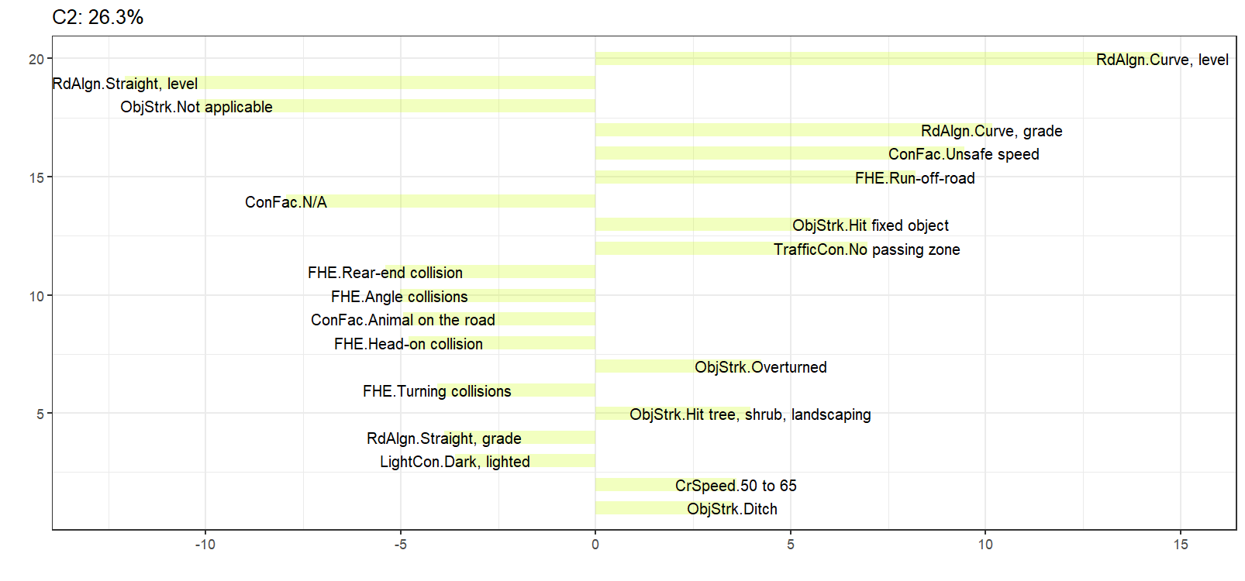
Cluster 2 Crashes with fixed objects on curves at unsafe speeds

Slide 27
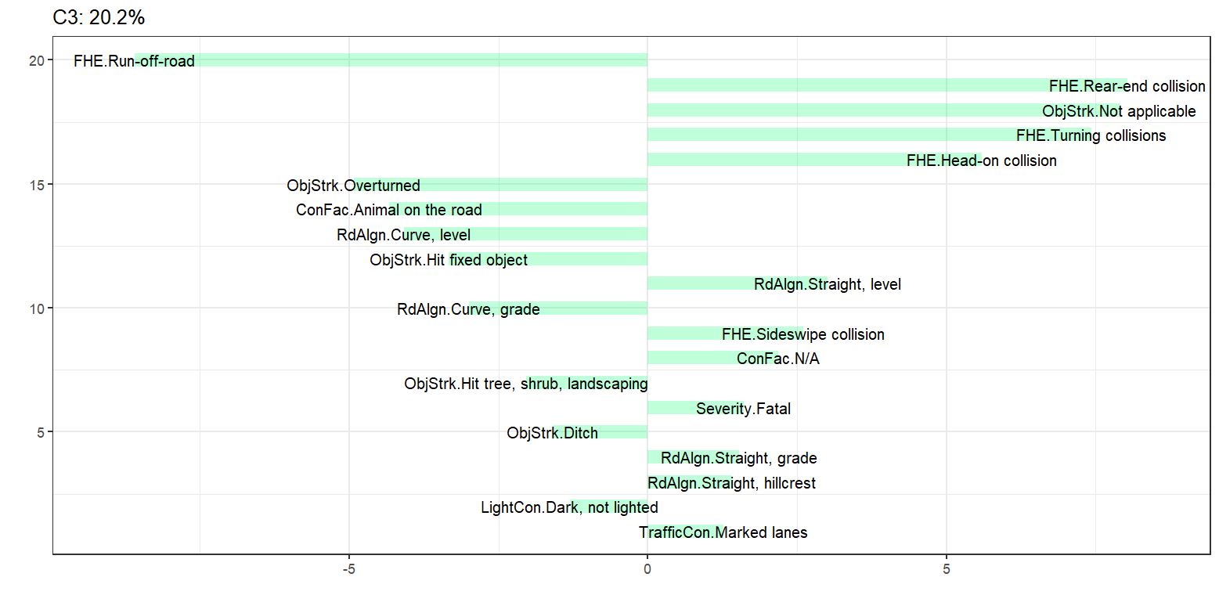
Cluster 3 Severe Straight Road Crashes with Riding Control Issues

Slide 28
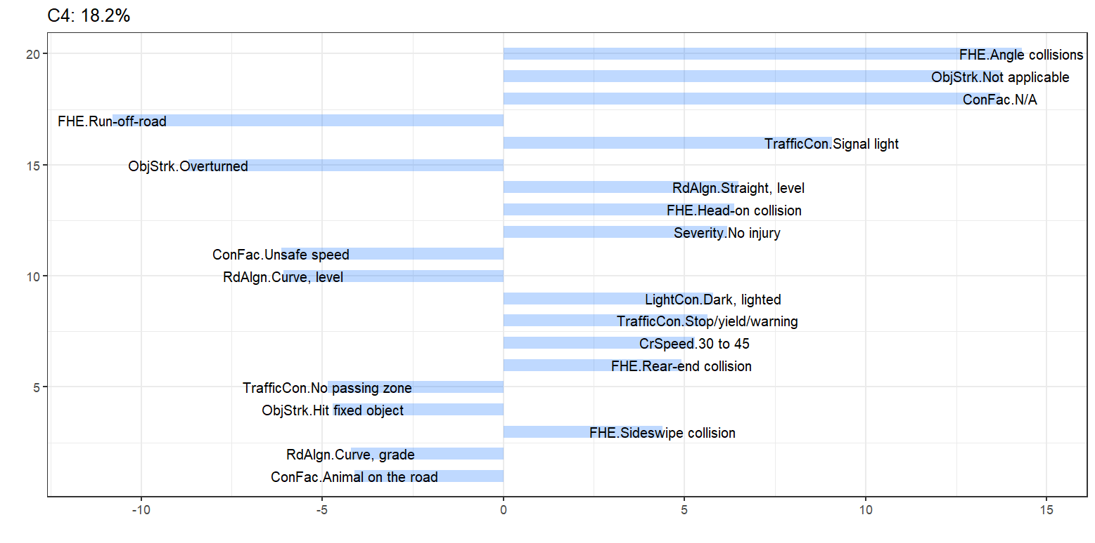
Cluster 4 Crashes at intersections under dark, lighted conditions

Slide 29
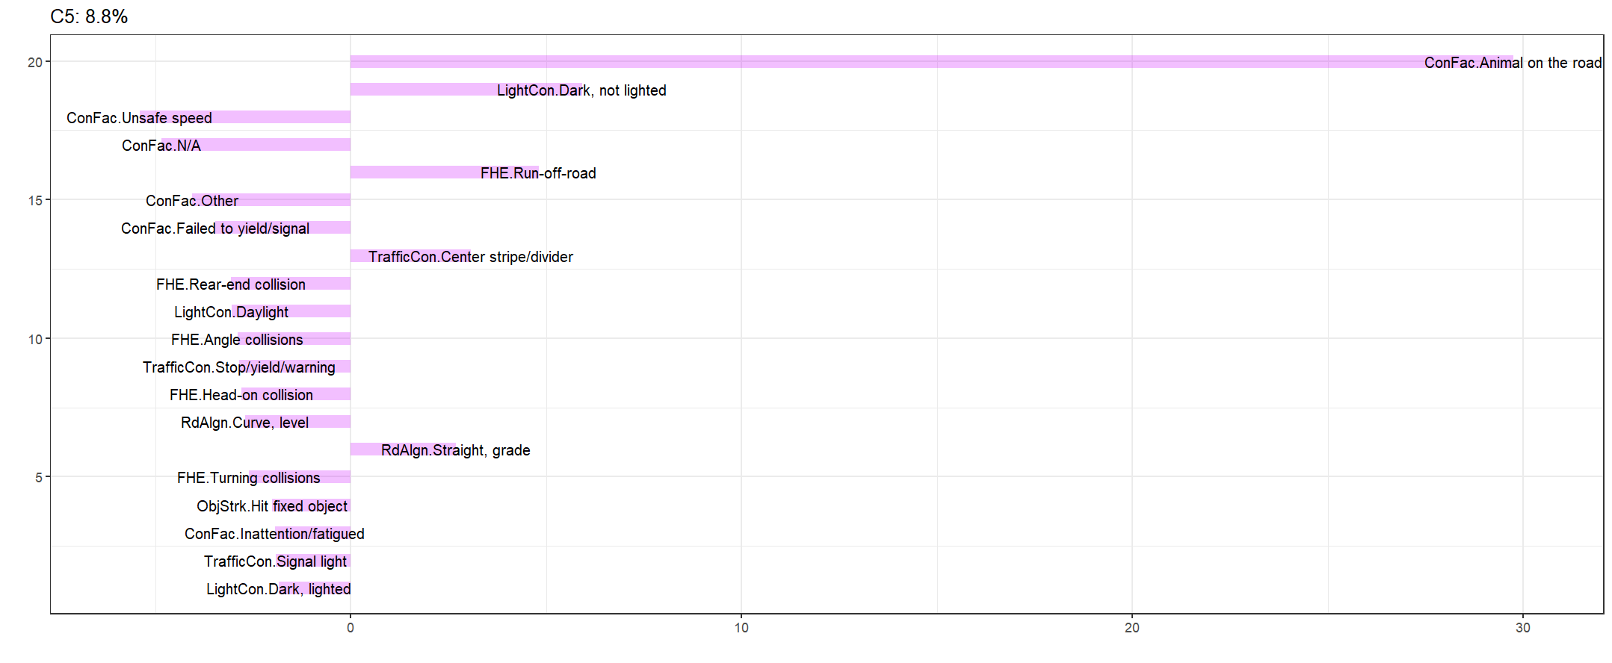
Cluster 5 Run-off-road crashes at night with animals present

Slide 30
Validation by SHAP

Slide 31
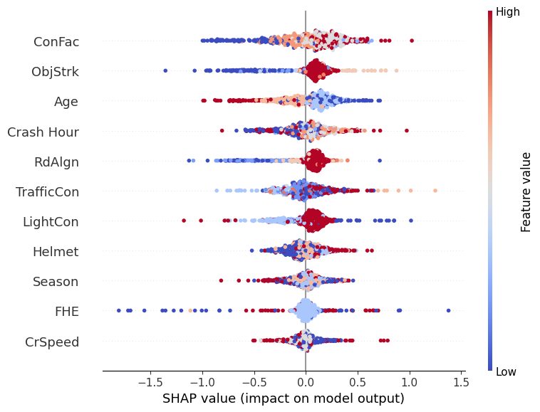
SHAP Summary Plots
Right Side Attributes from Cluster 1 | Feature Value | High/Low
ObjStrk.Overturned | 6 | High
ConFac.Other | 2 | Low
FHE.Run-off-road | 4 | Moderate
RdAlgn.Straight, level | 6 | High
CrSpeed.Greater than 65 | 2 | Low
ObjStrk.Other | 5 | High
ConFac.Inattention/fatigued | 1 | Low
RdAlgn.Straight, grade | 4 | Moderate
Cluster 1

Slide 32
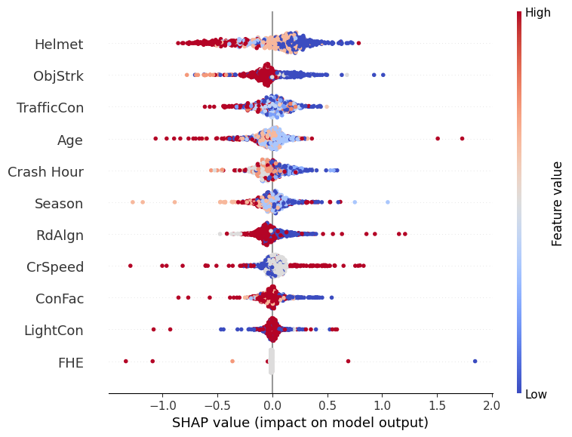
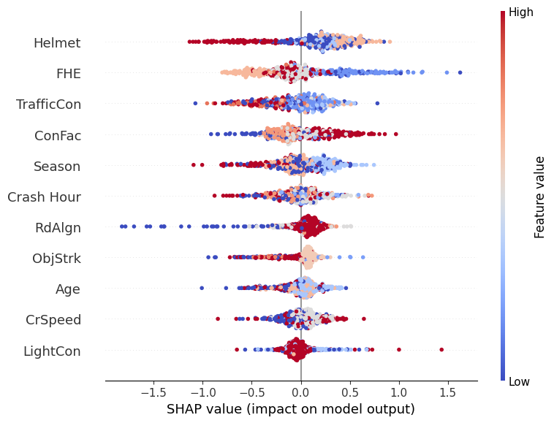
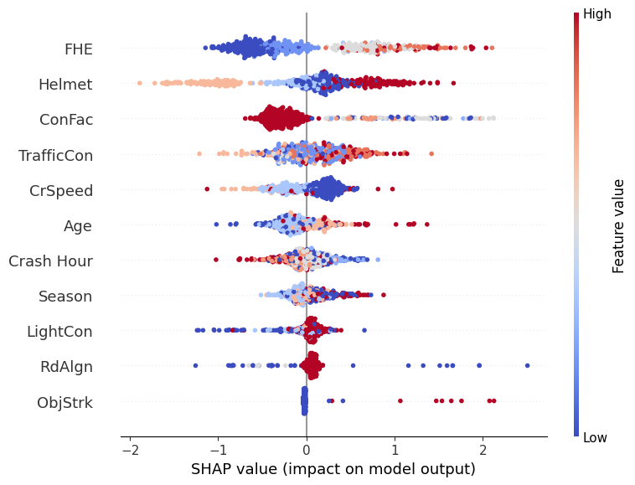
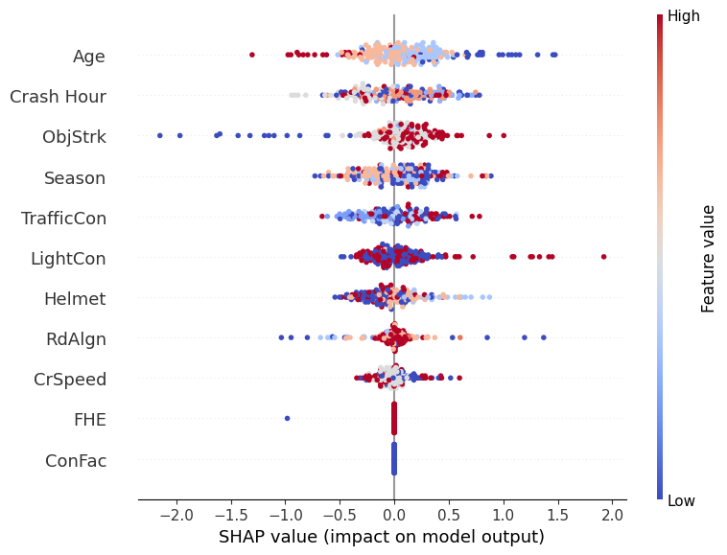
SHAP Summary Plots
Cluster 2
Cluster 3
RQ1. What behavioral, environmental, and roadway characteristics are most strongly associated with severe and fatal motorcycle crashes on rural undivided roadways, as identified through cluster correspondence analysis?
Cluster 4
Cluster 5

Slide 33

Random Parameter Logit Model Results

Slide 34
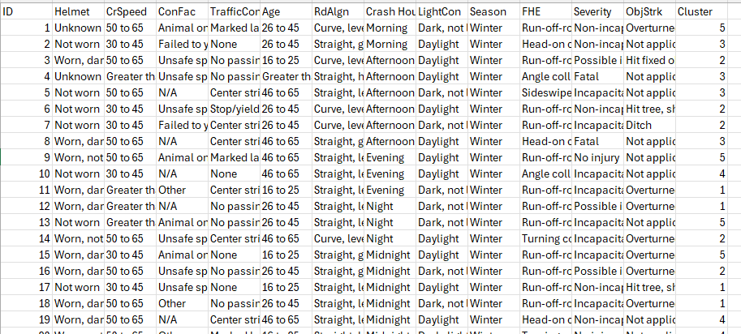
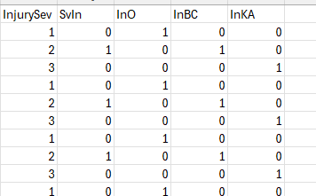
Study Design for RPL Models
K
KA
A
B
BC
C
O
O
One-hot encoded dataset
Cluster- based dataset
Injury level combinations
MNL
Cluster based 5 datasets
RPL
RPLHM
Variable Selection for RPL

Slide 35
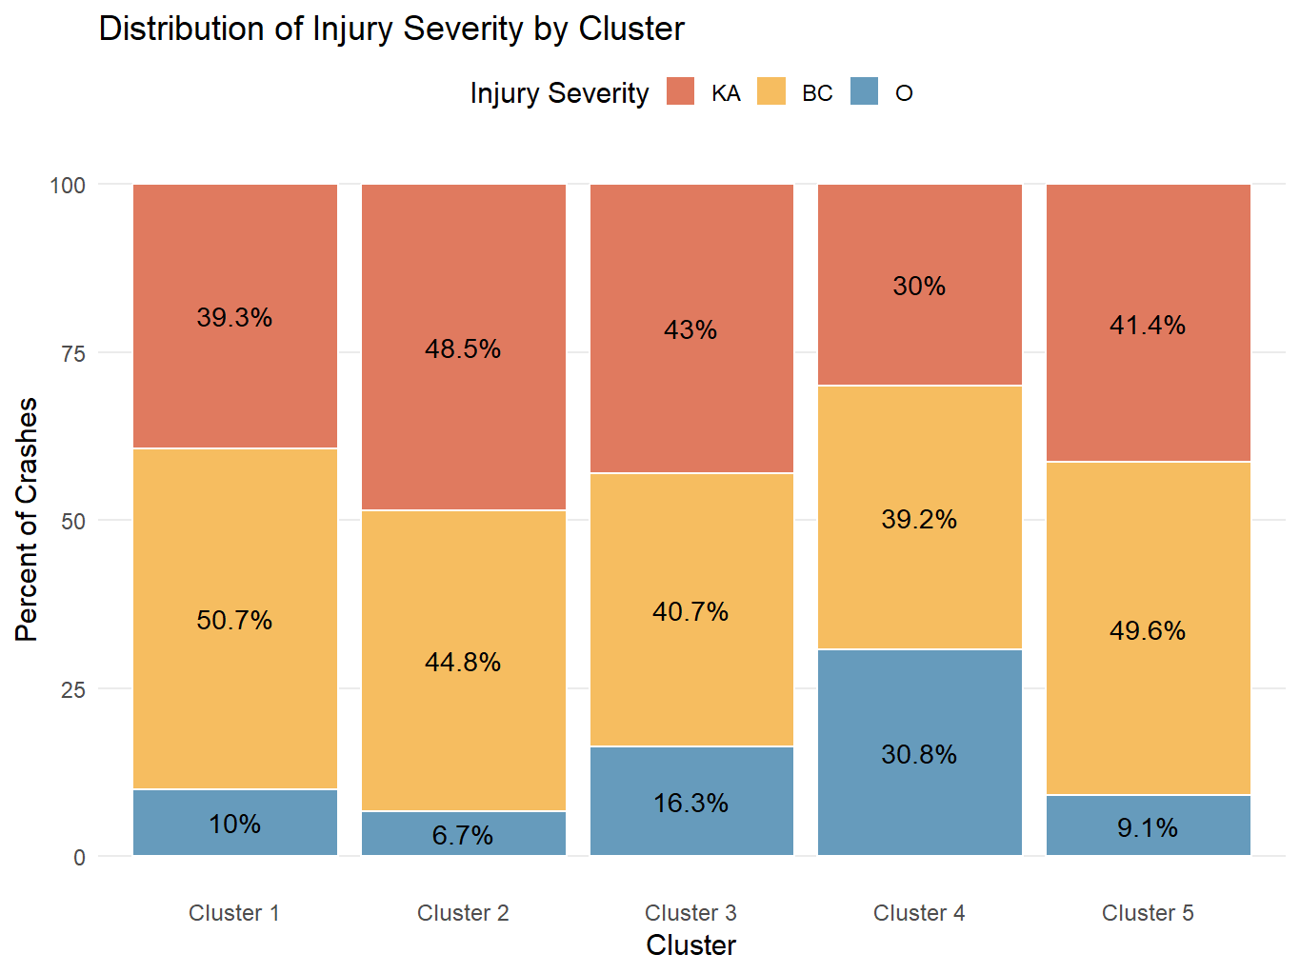
Cluster Based Injury Levels
Injury Levels | Total
KA | 5,223
BC | 5,728
O | 1,802
Total | 12,753

Slide 36
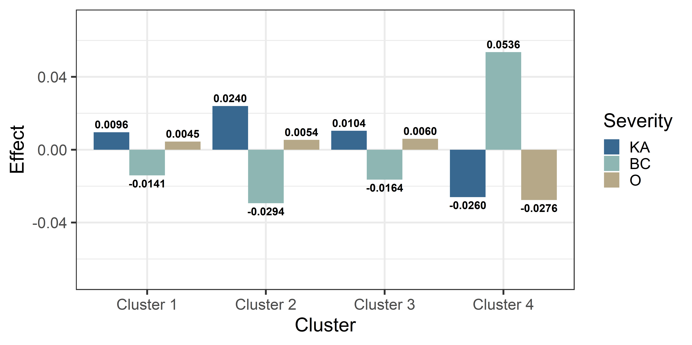
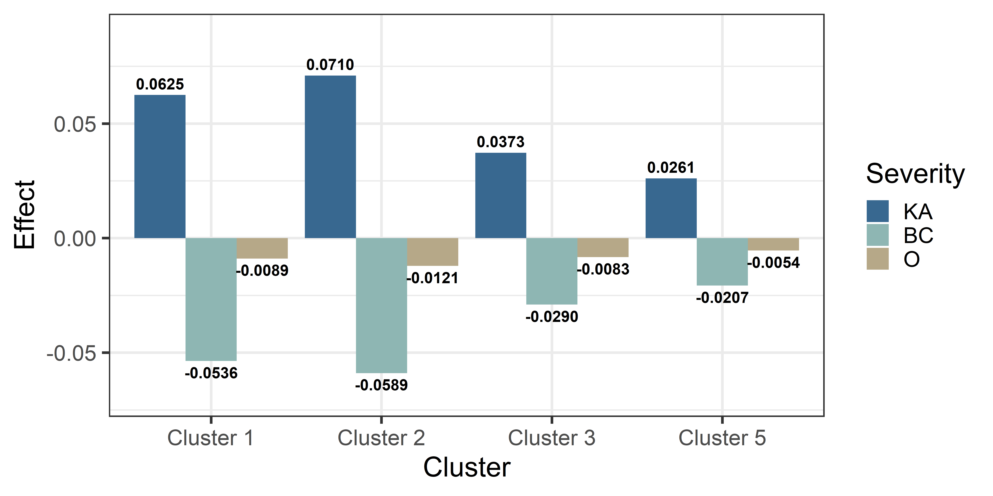
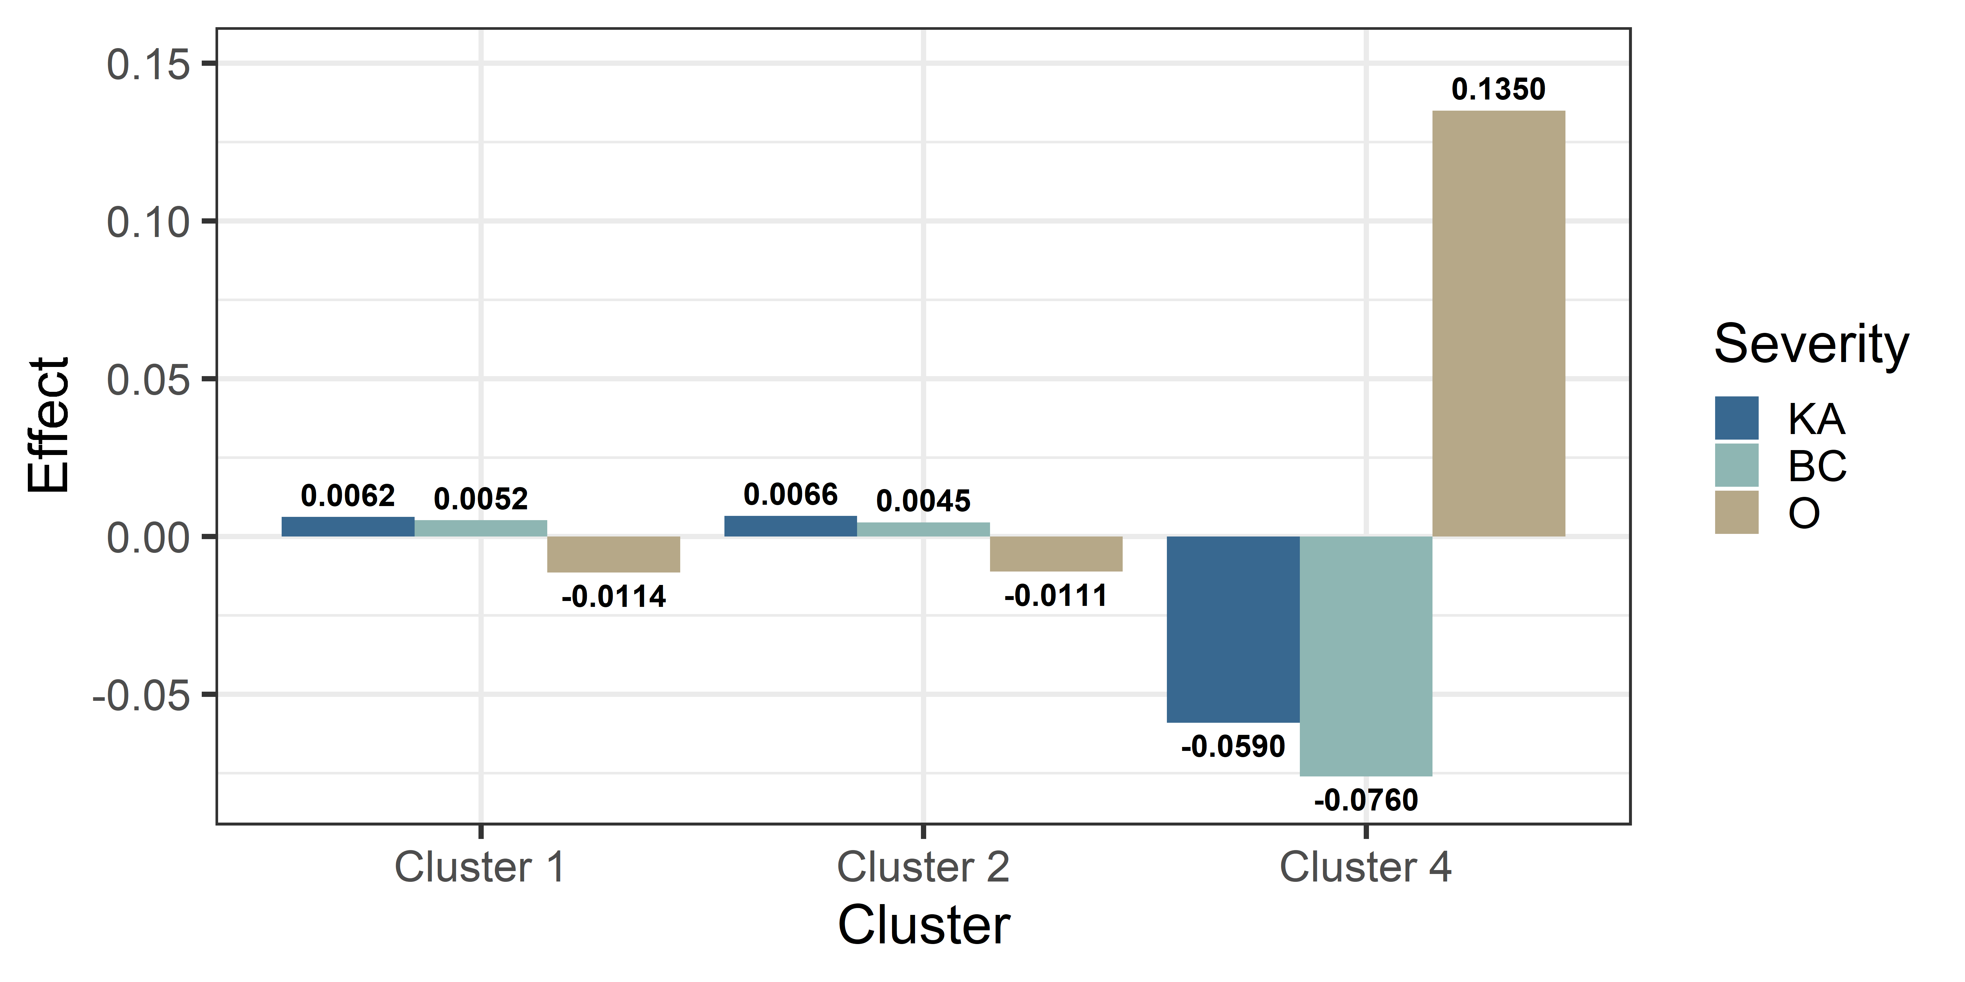
Rider Behavior
Helmet not worn (1 if not worn, 0 otherwise) [KA] | 1.583 (Cluster 1) ↑
Helmet worn, damaged (1 if damaged, 0 otherwise) [BC] | -0.526(Cluster 3) ↓ 0.233 (Cluster 4) ↑
Unsafe speed (1 if rider riding with an unsafe speed, 0 otherwise) [O] | -0.502 (Cluster 1) ↓ 0.641 (Cluster 4) ↑
Helmet not worn (1 if not worn, 0 otherwise) [KA] | 1.583 (Cluster 1) ↑
Helmet worn, damaged (1 if damaged, 0 otherwise) [BC] | -0.526(Cluster 3) ↓ 0.233 (Cluster 4) ↑
Unsafe speed (1 if rider riding with an unsafe speed, 0 otherwise) [O] | -0.502 (Cluster 1) ↓ 0.641 (Cluster 4) ↑
Helmet not worn (1 if not worn, 0 otherwise) [KA] | 1.583 (Cluster 1) ↑
Helmet worn, damaged (1 if damaged, 0 otherwise) [BC] | -0.526(Cluster 3) ↓ 0.233 (Cluster 4) ↑
Unsafe speed (1 if rider riding with an unsafe speed, 0 otherwise) [O] | -0.502 (Cluster 1) ↓ 0.641 (Cluster 4) ↑

Slide 37
Other Variables
Variable (Definition) | Coefficients
Rider Demographic
Rider age (1 if rider's age is greater than 65 years old, 0 otherwise) [O] | 0.965 (Cluster 3) ↑
Crash Speed
Crash speed 30-45 mph (1 if speed between 30 to 45 mph, 0 otherwise) [O] | -0.538 (Cluster 5) ↓ 0.279 (Cluster 4) ↑
Crash speed greater than 65 mph(1 if speed greater than 65 mph, 0 otherwise) [KA] | 1.035 (Cluster 3) ↑
Traffic Condition
Center stripe/divider (1 if present, 0 otherwise) [BC] | 0.283 (Cluster 5) ↑
Marked lane (1 if present, 0 otherwise) [O] | -0.643 (Cluster 1) ↓
Stop/yield/warning sign (1 if present, 0 otherwise) [KA] | 0.279 (Cluster 4) ↑
Roadway Characteristics
Curve grade (1 if curve/graded, 0 otherwise) [O] | 0.582 (Cluster 1) ↑
Straight level (1 if straight/level, 0 otherwise) [KA] | 0.549 (Cluster 1) ↑
Overturned (1 if overturned, 0 otherwise) [BC] | 1.078 (Cluster 1) ↑ -0.956 (Cluster 4) ↓
Variable (Definition) | Coefficients
Temporal Factors
Afternoon (1 if afternoon, 0 otherwise) [O] | -0.393 (Cluster 3) ↓
Morning (1 if morning, 0 otherwise) [KA] | 0.573 (Cluster 3) ↑
Fall (1 if fall, 0 otherwise) [KA] | 0.427 (Cluster 3) ↑
Lighting Condition
Dark, not lighted (1 if dark, 0 otherwise) [O] | -1.298 (Cluster 5) ↓
Daylight (1 if daylight, 0 otherwise) [BC] | 0.951 (Cluster 1) ↑
First Harmful Event
Rear-end (1 if rear-end, 0 otherwise) [BC] | 0.642 (Cluster 3) ↑
Run-off-road (ROR) (1 if ROR, 0 otherwise) [KA] | -1.868 (Cluster 3) ↓
Hit fixed object (1 if hit object, 0 otherwise) [BC] | -0.885 (Cluster 3) ↓

Slide 38
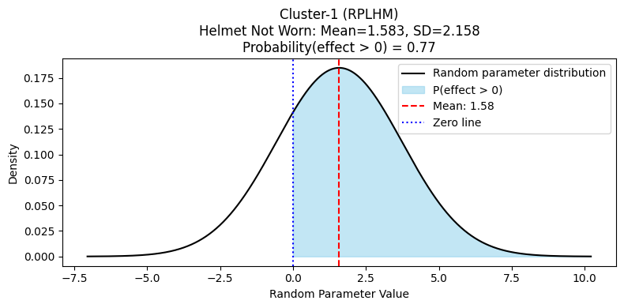
Random Parameter: Helmet not worn

Slide 39
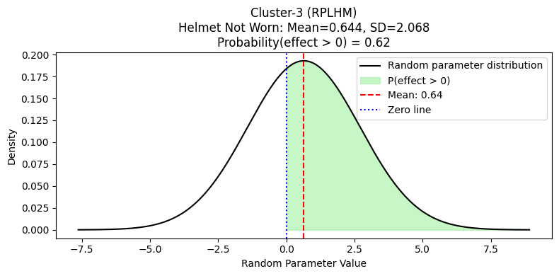
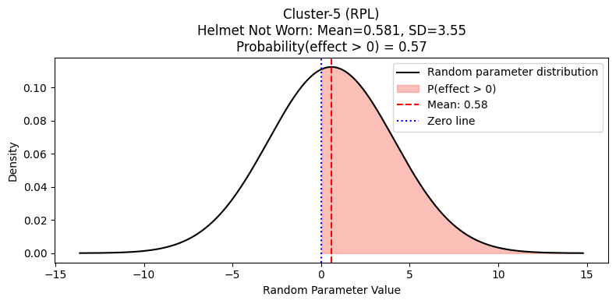
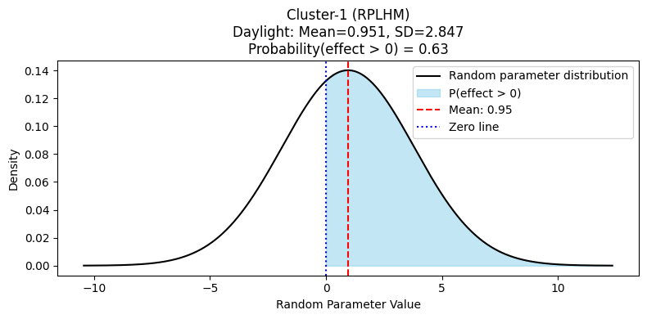
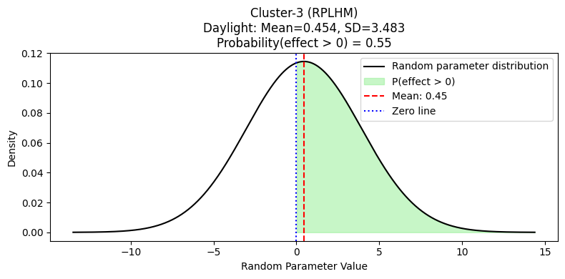
Random Parameter
Helmet not worn (Clusters 3 and 5)
Daylight (Clusters 1 and 3)

Slide 40
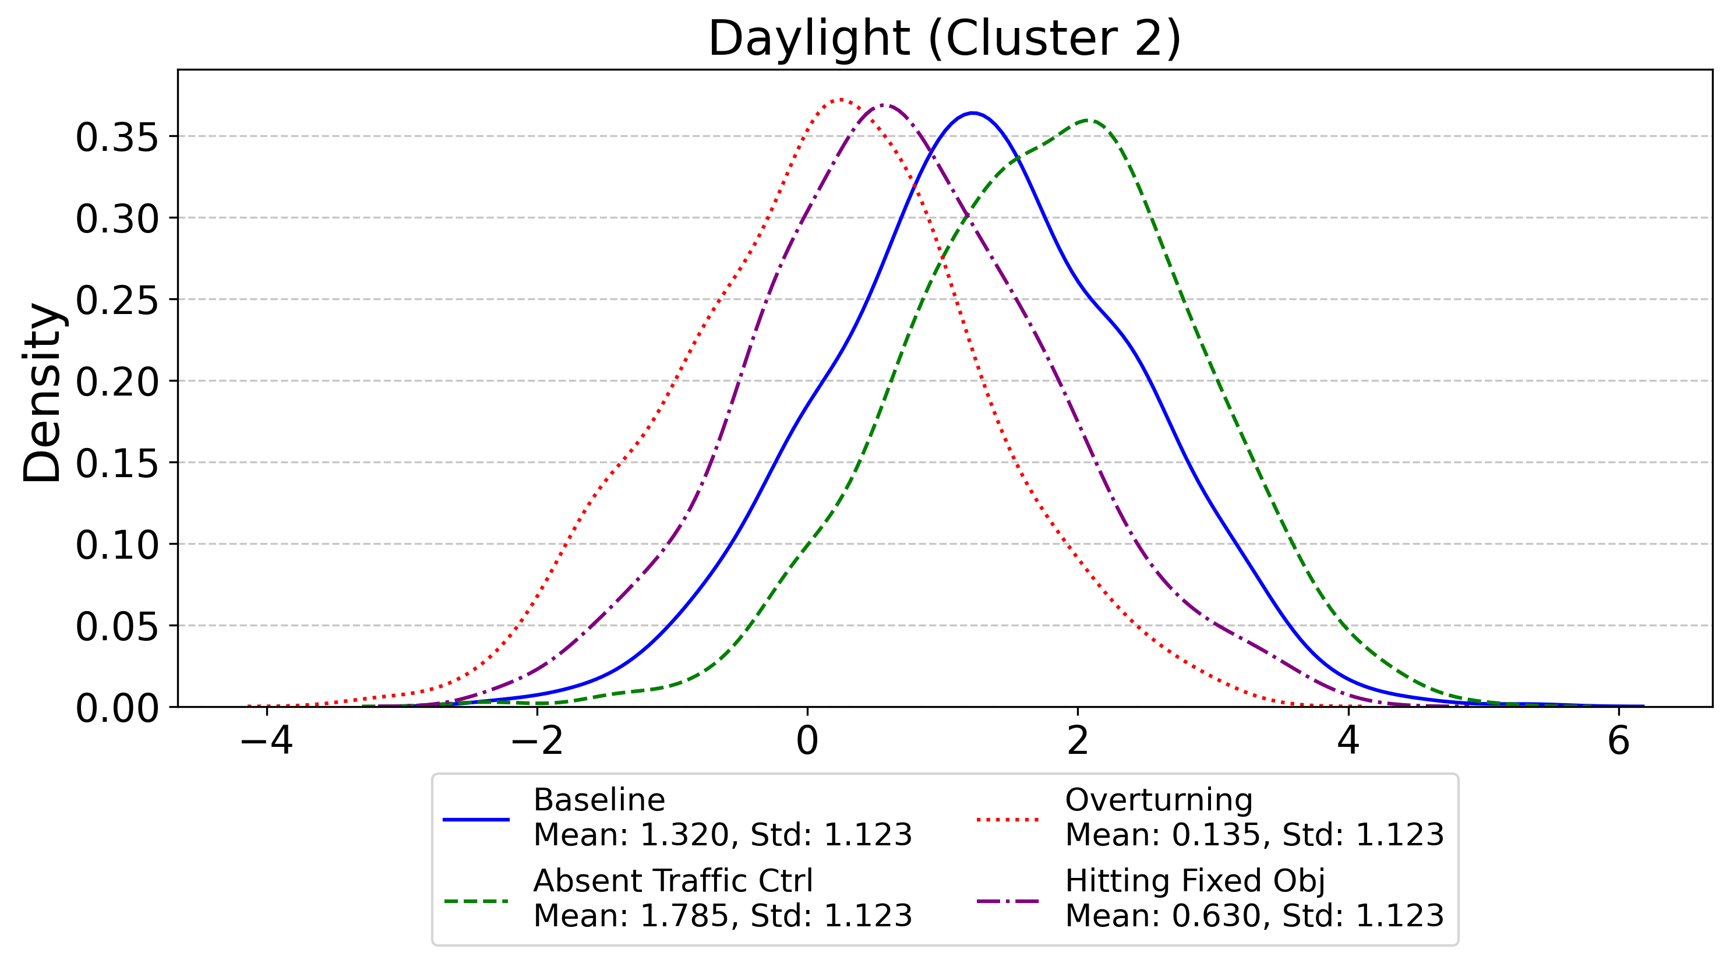
Heterogeneity in the Means
Daylight (Cluster 2)

Slide 41




Heterogeneity in the Means
Helmet not worn (Cluster 1)
Helmet not worn (Cluster 3)
RQ2. How does unobserved heterogeneity influence the relationship between crash risk factors and injury severity across different crash clusters on rural undivided roadways?
Daylight (Cluster 1)
Daylight (Cluster 3)

Slide 42
Narrative Data Analysis and Results

Slide 43

Topic 1: Speeding-Related Roadway Departure
Run-off road
Speeding, loss of control
Came to stop
Curved road

Slide 44




Topic 2: Single-Vehicle Roadway departure
Bigram Topic Modelling (Topic 2 to 5)
Topic 3: Turn Related Crash at Intersection
Topic 4: ROR Crashes on County Roads
Topic 5: Lane-Change and Speed Control Conflicts
RQ3. What key themes and topics emerge from the narrative crash data, and how do these narrative-driven factors relate to crash severity outcomes?

Slide 45

Convergent Validity

Slide 46
Convergent Validity
Cluster 1 (C1: 26.5%)- Overturns and run-off-road crashes at high speeds
Cluster 1
Marginal Effects
Bigram Topic Modeling
Overturned
ROR
Straight level
Speed > 65 mph
Inattention/fatigued
Straight grade
Overturned: BC: 0.1018 ↑
ROR: KA: -0.0481 ↓
Straight level: KA: 0.0559 ↑
Speed > 65 mph: KA 0.0232 ↑
Inattention/fatigued: Not sig.
Straight grade: Not sig.
Topic-1
ROR
Speeding
Curved road
Topic-2
Loss of control
Roadway departure
Curved road

Slide 47


Scenerio-1
High speed on straight level road > Loss of control (often inattention/fatigue) > Overturned or run-off-road crash
Selected Countermeasures
Mandatory helmet and gear checks
Advanced rider and fatigue training
Targeted speed checks, high-risk times
Promote rest, use reflective gear
Other factors
Helmet not worn/damaged ↑
Riders age > 65 y/o ↓
Afternoon ↑
Dark, not lighted ↑
Daylight ↓

Slide 48
Convergent Validity
Cluster 2 (C2: 26.3%) - Crashes with fixed objects on curves at unsafe speeds
Cluster 1
Marginal Effects
Bigram Topic Modeling
Curve level
Curve grade
Unsafe speed
ROR
Hit a fixed object
No passing zone
Overturned
Speed 50-65 mph
Ditch
Curve grade: KA: 0.0054 ↑
Unsafe speed: KA: 0.0066 ↑
ROR: KA: 0.1660 ↑
Hit a fixed object: Not sig.
No passing zone: Not sig.
Overturned: BC: 0.1750 ↑
Speed 50-65 mph: Not sig.
Ditch: Not sig.
Topic-1
ROR
Speeding
Curved road
Topic-2
Loss of control
Roadway departure
Curved road

Slide 49


Scenerio-2
Curved road at moderate to high speed > Loss of control (unsafe speed) > Run-off-road or overturn crash
Selected Countermeasures
Install flashing chevron curve signs
Add rumble strips before sharp curves
Targeted nighttime curve enforcement patrols
Motorcyclist curve speed safety workshops
Retroreflective edge lines and post delineators
Other factors
Helmet not worn/damaged ↑
Afternoon ↑
Dark, not lighted ↑
Daylight ↓

Slide 50
Convergent Validity
Cluster 3 (C3: 20.2%) - Severe Straight Road Crashes with Riding Control Issues
Cluster 1
Marginal Effects
Bigram Topic Modeling
Rear-end
Turning
Head-on
Straight level
Sideswipe
Straight grade/hillcrest
Marked lane
Rear-end: BC: 0.0236↑
Turning: Not sig.
Head-on: Not sig.
Straight level/grade: Not sig.
Sideswipe : Not sig.
Marked lane: KA: 0.0108↑
Topic-3
Left-turn maneuver
Failure to yield
Entry/exit to the driveway
Topic-5
Lane change
Loss of control
Driveway entries

Slide 51

Scenerio-3
Straight road (marked lane) > Maneuvering or control issues at the driveway entry/exit > Failure to yield or loss of control > Rear-end
Other factors
Helmet not worn/damaged ↑
Rider aged > 65 y/o ↓
Afternoon, Morning, and Fall ↑
Dark, not lighted ↑
Daylight ↓
Selected Countermeasures
Install high-visibility stop/yield signs
Add LED stop sign enhancements
Advance pavement markings at intersections
Increase intersection lighting, add reflective strips

Slide 52
Convergent Validity
Cluster 4 (C4: 18.2%) - Crashes at intersections under dark, lighted conditions
Cluster 1
Marginal Effects
Bigram Topic Modeling
Angular crash
Signal light
Straight level
Head-on
Dark, lighted
Stop/yield/warning
Speed 30-45 mph
Rear-end
Sideswipe
angular: Not sig.
Head-on: Not sig.
Signal light: Not sig.
Straight level/grade: Not sig.
Dark, not lighted: BC: 0.0646 ↑
Stop/yield/warning: KA: 0.0569 ↑
Speed 30-45 mph: O: 0.0588 ↑
Rear-end: Not sig.
Sideswipe: Not sig.
Topic-4
Left-turn maneuver
Failure to yield
Entry/exit to the driveway

Slide 53


Scenerio-4
Straight road (marked lane) > Maneuvering or control issues in intersections > Poor Lighting > Failure to yield or loss of control > rear-end/ sideswipe/ angular
Other factors
Helmet worn, damaged ↓
Rider aged > 65 y/o ↓
Dark, not lighted ↑
Daylight ↓
Selected Countermeasures
Install advanced warning flashers at intersections
Increase intersection lighting for better visibility
Dedicated motorcycle lane markings at crossings
Intersection approach rumble strips for alertness

Slide 54
Convergent Validity
Cluster 5 (C5: 8.8%) - Run-off-road crashes at night with animals present
Cluster 1
Marginal Effects
Bigram Topic Modeling
Animal
Dark, not lighted
ROR
Center stripe/divider
Straight grade
Animal: Not sig.
Dark, not lighted: BC: 0.0302 ↑
ROR: Not sig.
Center stripe/divider: BC: 0.0182↑
Straight grade: Not sig.
Topic-3
ROR
Rural road
Fencing
Minor Injury

Slide 55


Scenerio-5
Nighttime on unlit road > Presence of animals or center divider > Run-off-road event
Other factors
Helmet not worn ↑
Dark, not lighted ↑
Daylight ↓
Selected Countermeasures
Install wildlife crossing warning signs
Add reflective pavement markers, edge lines
Increase helmet enforcement and rider outreach
Enhance roadside fencing in animal zones
RQ4. How do the type and nature of the first harmful event influence injury severity in motorcycle crashes, and what factors explain variability in their impact?

Slide 56












Safe System Approach
Safe System Elements
Safe System Principal
Death and Serious Injuries are Unacceptable
Humans Make Mistakes
Humans are Vulnerable
Responsibility is Shared
Safety is Proactive
Redundancy is Crucial
Safer People
Safer Vehicles
Safer Speeds
Safer Roads
Post-Crash Care
It is a holistic and proactive method to eliminate traffic fatalities and serious injuries. This idea was first adopted in Sweden in 1997 as “Vision Zero” and since then has spread around the world.

Slide 57
Inclusion of Safe System Approach
SSA Element | Scenario 1: Straight, High Speed | Scenario 2: Curved, High Speed | Scenario 3: Intersection Maneuvers | Scenario 4: Intersection, poor lighting, Multi-Movement | Scenario 5: Rural Night/Animals
Safe Roads | – | Chevron signs, rumble strips, edge lines | High-vis stop/yield signs, LED signs, pavement markings, lighting | Warning flashers, lighting, motorcycle lane markings, rumble strips | Wildlife signs, reflective markers, fencing
Safe Road Users | Helmet & gear checks, fatigue training, rest | Curve speed workshops | – | – | Helmet enforcement, rider outreach
Safe Vehicles | – | – | – | – | –
Safe Speeds | Targeted speed checks | Nighttime curve enforcement | – | Rumble strips (speed calming) | –
Post-Crash Care | – | – | – | – | –

Slide 58
Key Takeaways
Crash risks are highly context-specific
The likelihood and severity of motorcycle crashes on rural roads change dramatically depending on road type, lighting, the presence of animals, and the specific maneuver (e.g., curves, intersections, run-off-road).
Behavioral factors amplify danger
Risky rider behaviors, especially not wearing a helmet, speeding, and riding when fatigued, consistently make severe crashes more likely, regardless of the environment.

Slide 59


Limitations
Only cluster-selected variables were analyzed, potentially omitting key predictors.
Effects of barrier types and roadside features were not examined.
Inconsistent crash narrative data may have limited topic modeling reliability.
Future Scope
Apply methods to urban roadways with complex traffic.
Compare single- and multi-vehicle motorcycle crashes.
Investigate the impact of specific physical barriers on crash severity.

Slide 60
References
Anastasopoulos, P.Ch., Mannering, F.L., 2011. An empirical assessment of fixed and random parameter logit models using crash- and non-crash-specific injury data. Accident Analysis & Prevention 43, 1140–1147. https://doi.org/10.1016/j.aap.2010.12.024
Arnadottir, A.T., Ulfarsson, G.F., Kim, S., 2025. Single-vehicle injury crashes on rural roads in Iceland: contribution of unforgiving roadsides to fatal and serious injuries of vehicle occupants. Traffic Safety Research 9, e000083–e000083. https://doi.org/10.55329/bkrk9175
Ashifur Rahman, M., Das, S., Sun, X., 2022. Using Cluster Correspondence Analysis to Explore Rainy Weather Crashes in Louisiana. Transportation Research Record 2676, 159–173. https://doi.org/10.1177/03611981221082582
Behnood, A., Mannering, F., 2017. The effect of passengers on driver-injury severities in single-vehicle crashes: A random parameters heterogeneity-in-means approach. Analytic Methods in Accident Research. https://doi.org/10.1016/j.amar.2017.04.001
Bhat, C.R., 2001. Quasi-random maximum simulated likelihood estimation of the mixed multinomial logit model. Transportation Research Part B: Methodological 35, 677–693. https://doi.org/10.1016/S0191-2615(00)00014-X
Blei, D.M., Ng, A.Y., Jordan, M.I., 2003. Latent Dirichlet Allocation. Journal of Machine Learning Research.
Carvalho, H.B.D., Andreuccetti, G., Rezende, M.R., Bernini, C., Silva, J.S., Leyton, V., D’Andréa Greve, J.M., 2016. Alcohol and drug involvement in motorcycle driver injuries in the city of Sao Paulo, Brazil: Analysis of crash culpability and other associated factors. Drug and Alcohol Dependence 162, 199–205. https://doi.org/10.1016/j.drugalcdep.2016.03.007
Chakraborty, R., Das, S., Mimi, M.S., Kutela, B., 2025a. Investigating Factor Associations in Barrier Crashes through Cluster Correspondence Analysis. Transportation Research Record 2679, 860–879. https://doi.org/10.1177/03611981241297976
Chakraborty, R., Das, S., Mimi, M.S., Kutela, B., 2024. Investigating Factor Associations in Barrier Crashes through Cluster Correspondence Analysis. Transportation Research Record: Journal of the Transportation Research Board. https://doi.org/10.1177/03611981241297976
Chakraborty, R., Mills, D., Das, S., 2025b. Children on wheels: Identifying crash determinants using cluster correspondence analysis. Accident Analysis & Prevention 216. https://doi.org/10.1016/j.aap.2025.108025
Chen, T., He, T., Benesty, M., Khotilovich, V., Tang, Y., Cho, H., Chen, K., Mitchell, R., Cano, I., Zhou, T., Li, M., Xie, J., Lin, M., Geng, Y., Li, Y., Yuan, J., implementation), Xgb. contributors (base Xgb., 2024. xgboost: Extreme Gradient Boosting.
Cheng, A.S.K., Ng, T.C.K., Lee, H.C., 2011. A comparison of the hazard perception ability of accident-involved and accident-free motorcycle riders. Accident Analysis & Prevention 43, 1464–1471. https://doi.org/10.1016/j.aap.2011.02.024
Christian, J.M., Thomas, R.F., Scarbecz, M., 2014. The Incidence and Pattern of Maxillofacial Injuries in Helmeted Versus Non-Helmeted Motorcycle Accident Patients. Journal of Oral and Maxillofacial Surgery 72, 2503–2506. https://doi.org/10.1016/j.joms.2014.07.015
Damsere-Derry, J., Ebel, B.E., Mock, C.N., Afukaar, F., Donkor, P., Kalowole, T.O., 2019. Evaluation of the effectiveness of traffic calming measures on vehicle speeds and pedestrian injury severity in Ghana. Traffic Injury Prevention. https://doi.org/10.1080/15389588.2019.1581925

Slide 61
References
Das, S., 2021a. Identifying key patterns in motorcycle crashes: findings from taxicab correspondence analysis. Transportmetrica A: Transport Science 17, 593–614. https://doi.org/10.1080/23249935.2020.1802362
Das, S., 2021b. Identifying key patterns in motorcycle crashes: findings from taxicab correspondence analysis. Transportmetrica A: Transport Science 17, 593–614. https://doi.org/10.1080/23249935.2020.1802362
Das, S., Avelar, R., Dixon, K., Sun, X., 2018. Investigation on the wrong way driving crash patterns using multiple correspondence analysis. Accident Analysis & Prevention 111, 43–55. https://doi.org/10.1016/j.aap.2017.11.016
Das, S., Dutta, A., Tsapakis, I., 2021. Topic Models from Crash Narrative Reports of Motorcycle Crash Causation Study. Transportation Research Record: Journal of the Transportation Research Board 2675, pp-449-462. https://doi.org/10.1177/03611981211002523
Das, S., Dzinyela, R., Liu, J., Dadashova, B., Silvestri-Dobrovolny, C., 2024a. Understanding patterns of factor influences in motorcycle crashes with fixed objects. Journal of Transportation Safety & Security 1–27. https://doi.org/10.1080/19439962.2024.2429077
Das, S., Dzinyela ,Richard, Liu ,Jinli, Dadashova ,Bahar, and Silvestri-Dobrovolny, C., 2025a. Understanding patterns of factor influences in motorcycle crashes with fixed objects. Journal of Transportation Safety & Security 17, 483–509. https://doi.org/10.1080/19439962.2024.2429077
Das, S., Jafari, M., Dzinyela, R., Khan, M.N., 2025b. Applying hybrid dimension reduction and econometric model to investigate rider behaviors in roadway departure motorcycle crashes. Transportation Letters 1–21. https://doi.org/10.1080/19427867.2025.2516422
Das, S., Jafari, M., Hossain, A., Chakraborty, R., Mimi, M.S., 2024b. Toll road crash severity using mixed logit model incorporating heterogeneous mean structures. Transportmetrica A: Transport Science 1–21. https://doi.org/10.1080/23249935.2024.2343755
Das, S., Mousavi, S.M., Shirinzad, M., 2022. Pattern recognition in speeding related motorcycle crashes. Journal of Transportation Safety & Security 14, 1121–1138. https://doi.org/10.1080/19439962.2021.1877228
Das, S., Sakib, N., Geedapally, S., Wei, Z., 2025c. Understanding Pedestrian Hit and Run Crash Patterns using Louisiana Data. Transportation Safety and Environment. https://doi.org/10.1093/tse/tdaf039
Das, S., Sun, X., 2014. Exploring Clusters of Contributing Factors for Single-Vehicle Fatal Crashes Through Multiple Correspondence Analysis.
Das, S., Tabesh, M., Dadashova, B., Dobrovolny, C., 2023a. Diagnosis of Encroachment-Related Work-Zone Crashes by Applying Pattern Recognition. Transportation Research Record: Journal of the Transportation Research Board 2677, 222–236. https://doi.org/10.1177/03611981231152254
Das, S., Tamakloe, R., Zubaidi, H., Obaid, I., Ashifur Rahman, M., 2023b. Bicyclist injury severity classification using a random parameter logit model. International Journal of Transportation Science and Technology 12, 1093–1108. https://doi.org/10.1016/j.ijtst.2023.02.001
de Rome, L., Fitzharris, M., Baldock, M., Fernandes, R., Ma, A., Brown, J., 2016. The prevalence of crash risk factors in a population-based study of motorcycle riders. Injury 47, 2025–2033. https://doi.org/10.1016/j.injury.2016.03.033
De Rome, L., Ivers, R., Fitzharris, M., Haworth, N., Heritier, S., Richardson, D., 2012. Effectiveness of motorcycle protective clothing: Riders’ health outcomes in the six months following a crash. Injury 43, 2035–2045. https://doi.org/10.1016/j.injury.2011.10.025

Slide 62
References
TxDOT, 2024. CRIS Query [WWW Document]. URL https://cris.dot.state.tx.us/public/Query/app/home (accessed 6.18.25).
Ukkusuri, S., Miranda-Moreno, L.F., Ramadurai, G., Isa-Tavarez, J., 2012. The Role of Built Environment on Pedestrian Crash Frequency. Safety Science, First International Symposium on Mine Safety Science and Engineering 2011 50, 1141–1151. https://doi.org/10.1016/j.ssci.2011.09.012
USDOT, 2024. Traffic Safety Facts | 2022 Data (No. DOT HS 813 589).
USDOT, 2023. What Is a Safe System Approach? | US Department of Transportation [WWW Document]. URL https://www.transportation.gov/safe-system-approach (accessed 6.18.25).
Wang, M.-H., 2022. Investigating the Difference of Factors Contributing to Motorcyclist Fatalities in Single Motorcycle and Multiple Vehicle Crashes in Taiwan. p. 17p.
Washington, S., Karlaftis, M.G., Mannering, F., Anastasopoulos, P., 2020. Statistical and Econometric Methods for Transportation Data Analysis. CRC Press.
Xin, C., Wang, Z., Lee, C., Lin, P.-S., 2017a. Modeling Safety Effects of Horizontal Curve Design on Injury Severity of Single-Motorcycle Crashes with Mixed-Effects Logistic Model. Transportation Research Record: Journal of the Transportation Research Board pp-38-46. https://doi.org/10.3141/2637-05
Xin, C., Wang, Z., Lin, P.-S., Lee, C., Guo, R., 2017b. Safety Effects of Horizontal Curve Design on Motorcycle Crash Frequency on Rural, Two-Lane, Undivided Highways in Florida. Transportation Research Record: Journal of the Transportation Research Board 2637, 1–8. https://doi.org/10.3141/2637-01
Ye, Y., He, J., Yan, X., Wang, C., Qin, P., 2025. Exploring determinants of motorcyclist non-violation crash injury severities on suburban roads of China: a random parameter logit model with heterogeneity in means and variances. Transportation Letters 0, 1–12. https://doi.org/10.1080/19427867.2025.2474317
Yu, M., Zheng, C., Ma, C., 2020. Analysis of injury severity of rear-end crashes in work zones: A random parameters approach with heterogeneity in means and variances. Analytic Methods in Accident Research. https://doi.org/10.1016/j.amar.2020.100126
Zhao, H., Chen, R., Deng, G., Yin, Z., Yang, G., Liu, S., Chen, H., Wang, Z., 2011. Comparison of injuries sustained by drivers and pillion passengers in fatal head-on motorcycle collision accidents. Forensic Science International 207, 188–192. https://doi.org/10.1016/j.forsciint.2010.10.003
Zhao, X., Zhan, M., Jie, C., 2018. Examining multiplicity and dynamics of publics’ crisis narratives with large-scale Twitter data. Public Relations Review 44, 619–632. https://doi.org/10.1016/j.pubrev.2018.07.004

Slide 63

In memory of
Epson Bhatta
Nineteen-year-old Nepali international student Epson Bhatta, who came to the United States 15 months ago to pursue his education, tragically lost his life in a motorcycle crash near Sewell Park in San Marcos, Texas, on the evening of March 22, 2025.

Slide 64

THANK YOU!
Swastika Barua
Graduate Student,
Ingram School of Engineering
Texas State University
Email: qwx11@txstate.edu

